Slide 1
BIG DATA ANALYTICS (DSE 3264)
Faculty Name:
Shavantrevva S Bilakeri (ssb)
Assistant Professor, Dept of DSCA, MIT.
Phone No: +91 8217228519 E-mail: ss.bilakeri@manipal.edu

Slide 2
Course Objectives
To be familiar with overview of Apache Hadoop Ecosystem
Understand the storage mechanism, architecture, features and execution modes of big data tools (Pig, Hive, HBase, Spark)
To be proficient in data analysis and its implications on structured, unstructured, and semi- structured data.
To be proficient with Big Data framework and use cases.

Slide 3
Course Outcome
Identify Big Data and its business inferences.
Explore, Manage and Analyze Job executions in local & cluster-based Hadoop environment.
Apply and Perform machine learning techniques using Scala & python.

Slide 4
Syllabus
Introduction to Big Data: evolution, structuring elements, big data analytics, distributed and parallel computing for big data, Life cycle of Big data, Cloud computing and big data, in-memory computing technology for big data, Big Data Stack, Layer Structure, Big Data Layout.
Hadoop: ecosystem, Hadoop Distributed File System (HDFS),
MapReduce: MapReduce Framework, optimizing MapReduce jobs, MapReduce Applications, Understanding YARN architecture.
Big Data Tools: “PIG”: History, Features, Architecture, Components, Data Models, Operators, Running & Executing Modes, Analysing data with Pig, Pig Libraries, Processing Structured Data using Pig.

Slide 5
Syllabus
Big Data Tools: “HBASE”: History, Characteristics, Features, Architecture, Storage Mechanism, HDFS Versus HBASE, HBase Query writing.
Big Data Tools: “Hive”: Brief History of Hive, Data Types In Hive, Executing Modes, Writing & Executing Hive queries.
Big Data tools: “Apache Spark”: Spark Architecture, Components, Features, Spark vs Hadoop, RDD, Need for RDD, Spark memory management & Fault tolerance, Spark’s Python and Scala shells, Programming with RDD: RDD Operations, Passing Functions to Spark, Common Transformations and Actions,

Slide 6
Contents
Introduction to Big Data
Types of Big Data
Big Data characteristics
Challenges
Data Generators (Fields of Big Data)
Traditional Vs Big Data approach
Life Cycle
Case Study.

Slide 7
Big Data Analytics
Data Analytics
Big Data is a massive amount of datasets that cannot
be stored, processed, or analyzed using traditional tools.
Insight Into data
The term big data was first used to refer to increasing data volumes in the mid-1990s.
In 2001, Doug Laney, then an analyst at consultancy Meta Group Inc., expanded the definition of big data.
Volume of data being stored and used by organizations.
Variety of data being generated by organizations.
Velocity, or speed, in which that data was being created and updated.
Using toos and Processes
Representations, Visualization, decision making

Slide 8
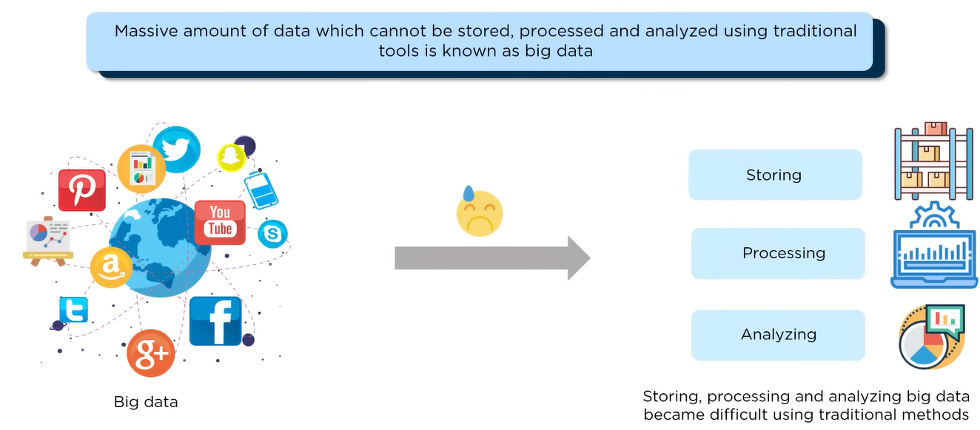
Why Big Data Analytics

Slide 9
Small Data VS Big Data
SL.NO | Small Data | Big Data
1 | Structured | Structured /Unstructured/ semistructured/
2 | Megabyte (MB): 1 MB is equivalent to 1,024 kilobytes or approximately 1 million bytes. Gigabyte (GB): 1 GB equals 1,024 megabytes or approximately 1 billion bytes. Terabyte (TB): 1 TB is equal to 1,024 gigabytes or approximately 1 trillion bytes. | Petabyte (PB): 1 PB is equivalent to 1,024 terabytes or 1 million gigabytes. Exabyte (EB): 1 EB equals 1,024 petabytes or 1 billion gigabytes. Zettabyte (ZB): 1 ZB is equal to 1,024 exabytes or 1 trillion gigabytes. Yottabyte (YB): 1 YB represents 1,024 zettabytes or 1 quadrillion gigabytes.
3 | Gradually Increases (Slow) | Exponentially/ Rapidly Increases
4 | Locally Present | Globally Present
5 | Centralized | Distributed
6 | Frameworks:Oracle, SQL Server | Hadoop, Spark, Cassandra
7 | Single Node | Multiple Node

Slide 10
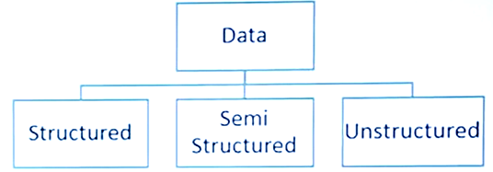
TYPES OF DATA

Slide 11
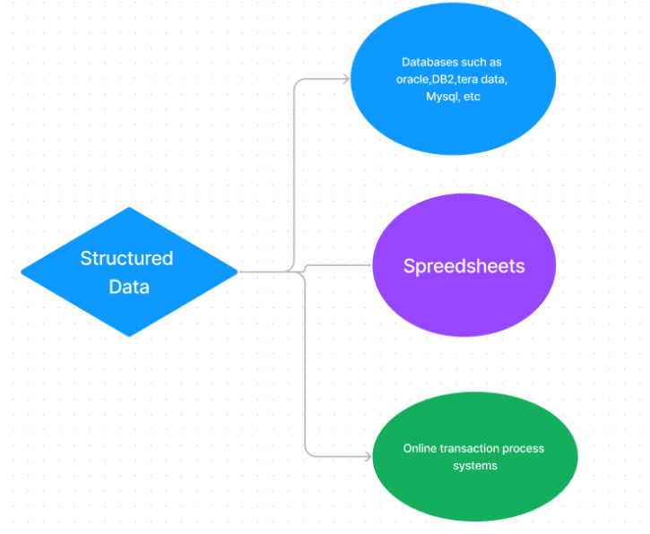
Structured
Data that resides in a fixed field within a record.
It is type of data most familiar to our everyday lives. Ex: birthday, address
A certain schema binds it, so all the data has the same set of properties. Structured data is also called relational data.
It is split into multiple tables to enhance the integrity of the data by creating a single record to depict an entity.
Relationships are enforced by the application of table constraints.

Slide 12
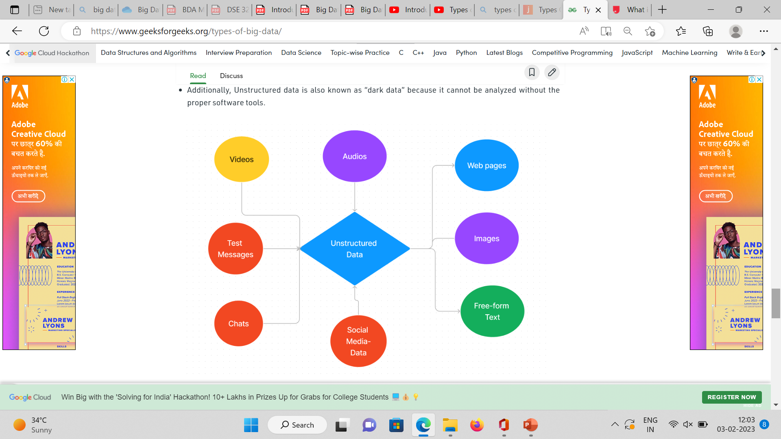
Unstructured
Unstructured data is the kind of data that doesn’t adhere to any definite schema or set of rules.
Its arrangement is unplanned and haphazard.
Photos, videos, text documents, and log files can be generally considered unstructured data.
Even though the metadata accompanying an image or a video may be semi-structured, the actual data being dealt with is unstructured.
Additionally, Unstructured data is also known as “dark data” because it cannot be analyzed without the proper software tools.

Slide 13
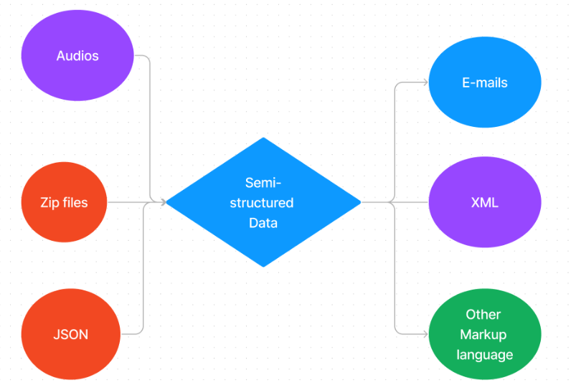
Semi- Structured
Semi-structured data is not bound by any rigid schema for data storage and handling.
The data is not in the relational format and is not neatly organized into rows and columns like that in a spreadsheet.
However, there are some features like key-value pairs that help in discerning the different entities from each other.
Since semi-structured data doesn’t need a structured query language, it is commonly called NoSQL data.
This type of information typically comes from external sources such as social media platforms or other web-based data feeds.

Slide 14
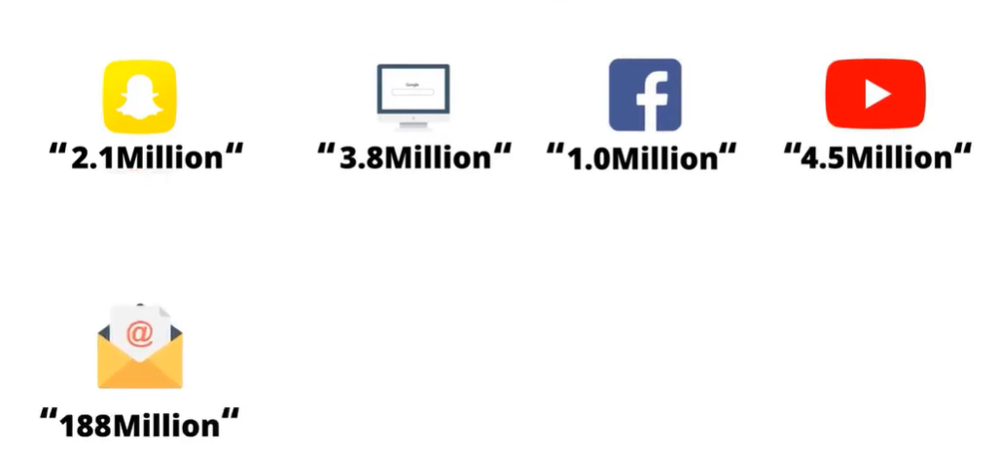
Data Generated On internet – Per minute

Slide 15
Examples of Big Data
Big data is a clustered management of different forms of data
Generated by various devices (Android, iOS, etc.),
Applications (music apps, web apps, game apps, etc.),
Actions (searching through SE, navigating through similar types of web pages, etc.).

Slide 16
Challenges of Big Data
Rapid Data Growth: The growth velocity at such a high rate creates a problem to look for insights using it. There is no 100% efficient way to filter out relevant data.
Storage: The generation of such a massive amount of data needs space for storage, and organizations face challenges to handle such extensive data without suitable tools and technologies.
Unreliable Data: It cannot be guaranteed that the big data collected and analyzed are totally (100%) accurate. Redundant data, contradicting data, or incomplete data are challenges that remain within it.
Data Security: Firms and organizations storing such massive data (of users) can be a target of cybercriminals, and there is a risk of data getting stolen. Hence, encrypting such colossal data is also a challenge for firms and organizations.

Slide 17
Fields of data that come under the umbrella of Big Data: (Generators of Data)
Black Box Data: Black box data is a type of data that is collected from private and government helicopters, airplanes, and jets. This data includes the capture of Flight Crew Sounds, separate recording of the microphone as well as earphones, etc.
Stock Exchange Data: Stock exchange data includes various data prepared about 'purchase' and 'selling' of different raw and well-made decisions.
Social Media Data: This type of data contains information about social media activities that include posts submitted by millions of people worldwide.
Transport Data: Transport data includes vehicle models, capacity, distance (from source to destination), and the availability of different vehicles.
Search Engine Data: Retrieve a wide variety of unprocessed information that is stored in SE databases.

Slide 18
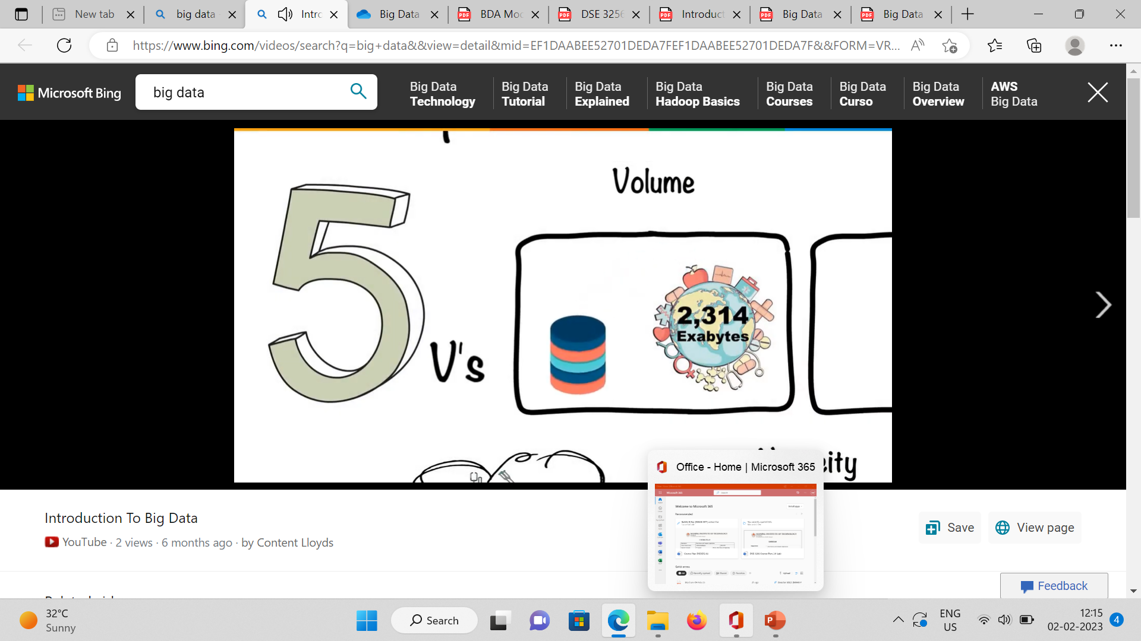
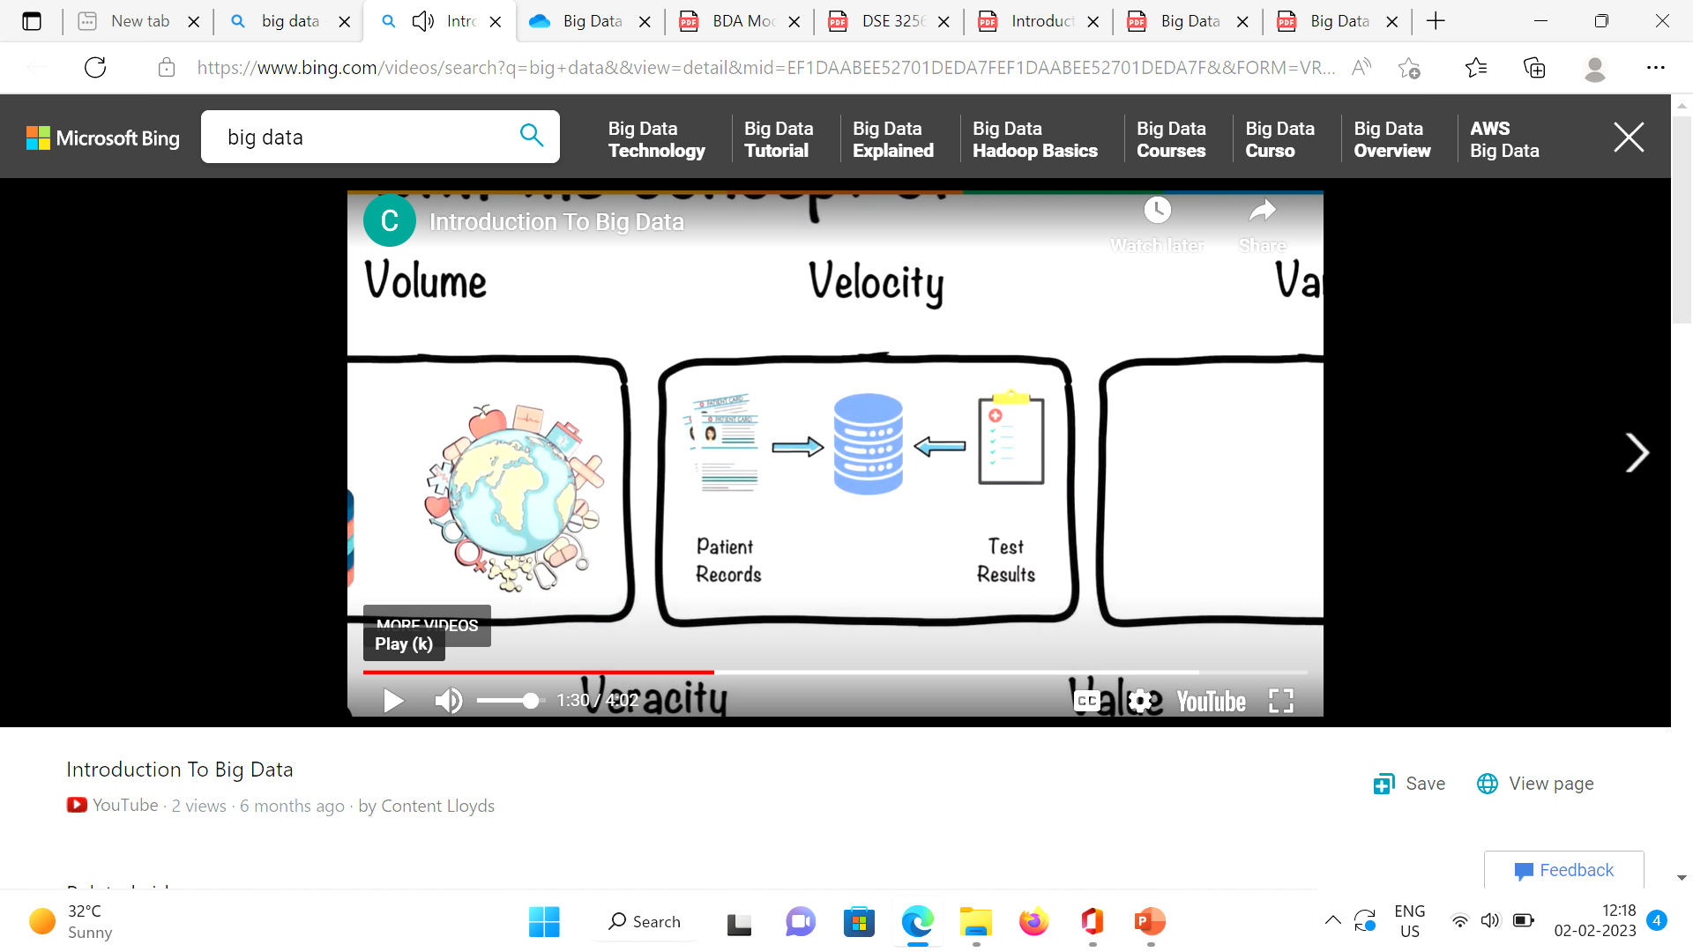
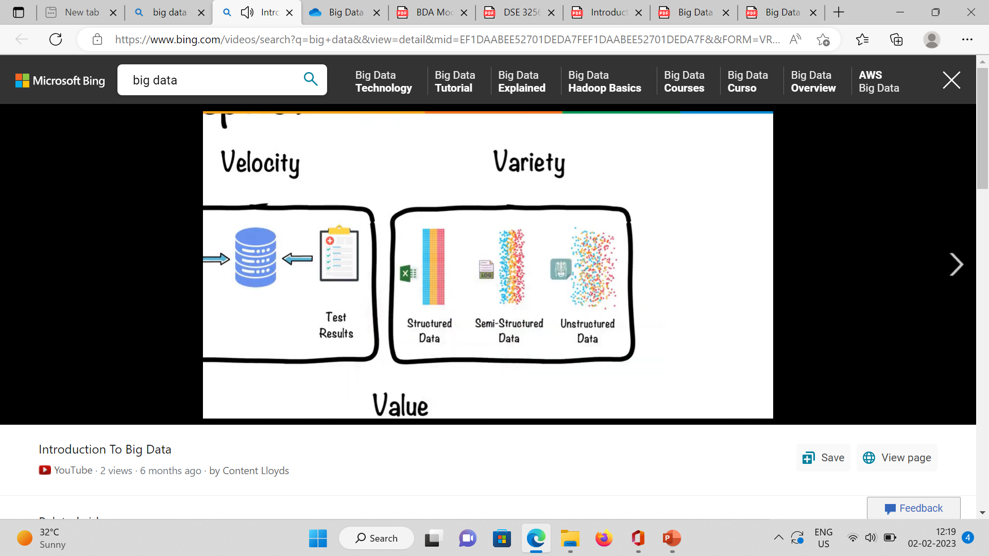
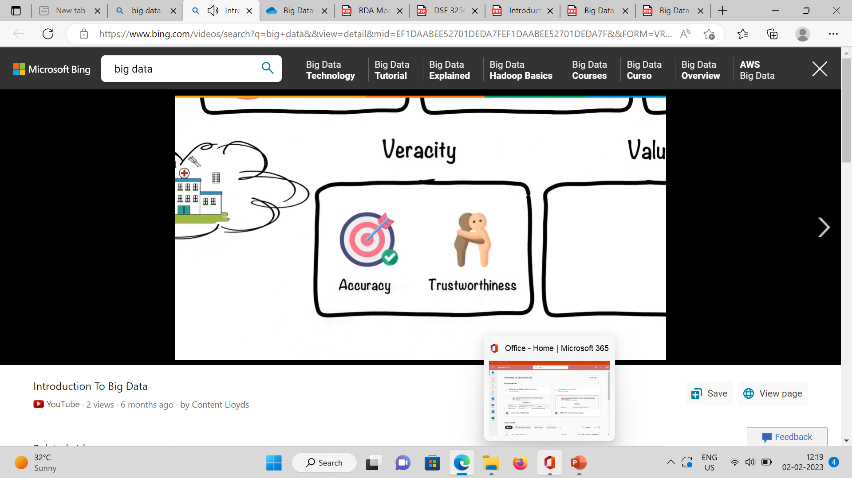
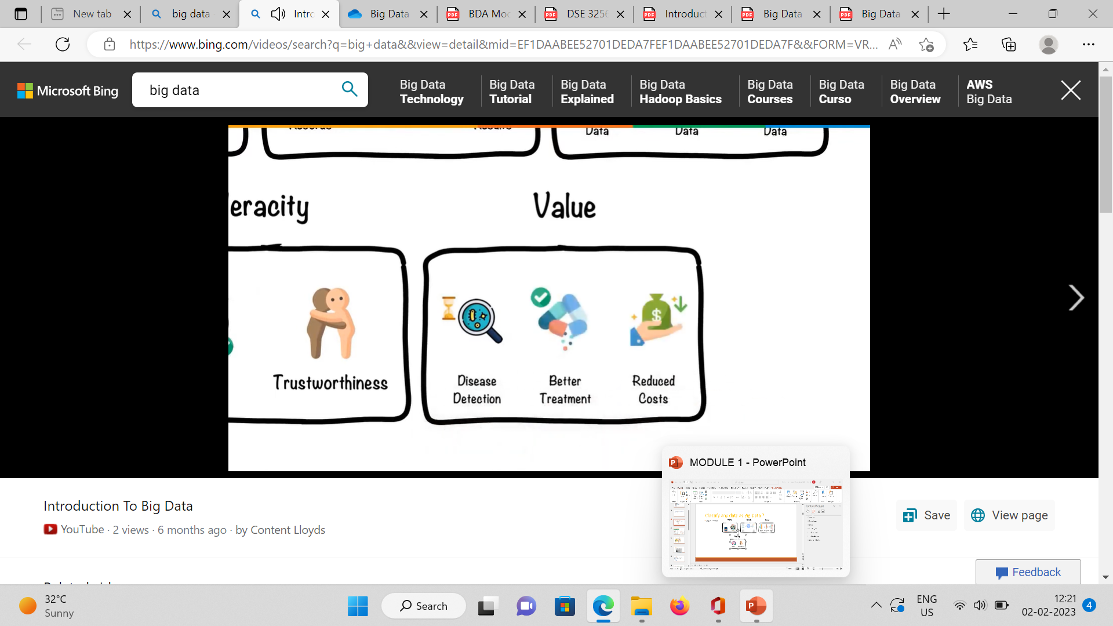
Classify any data as Big Data ?
Based on 5V’s.

Slide 19
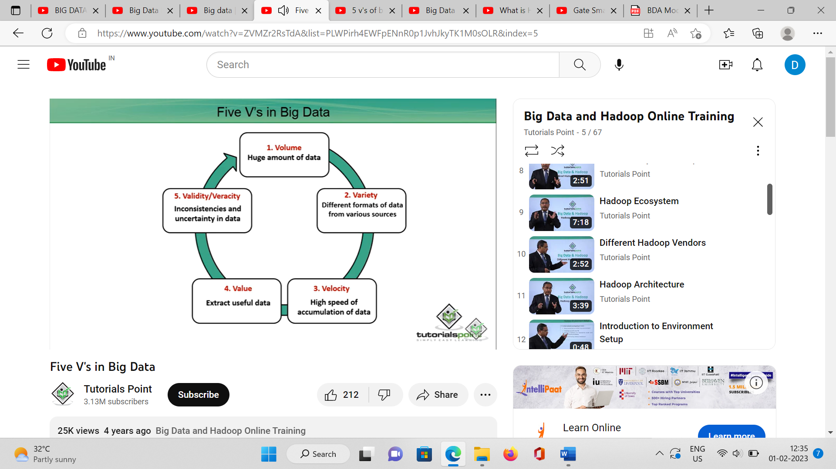
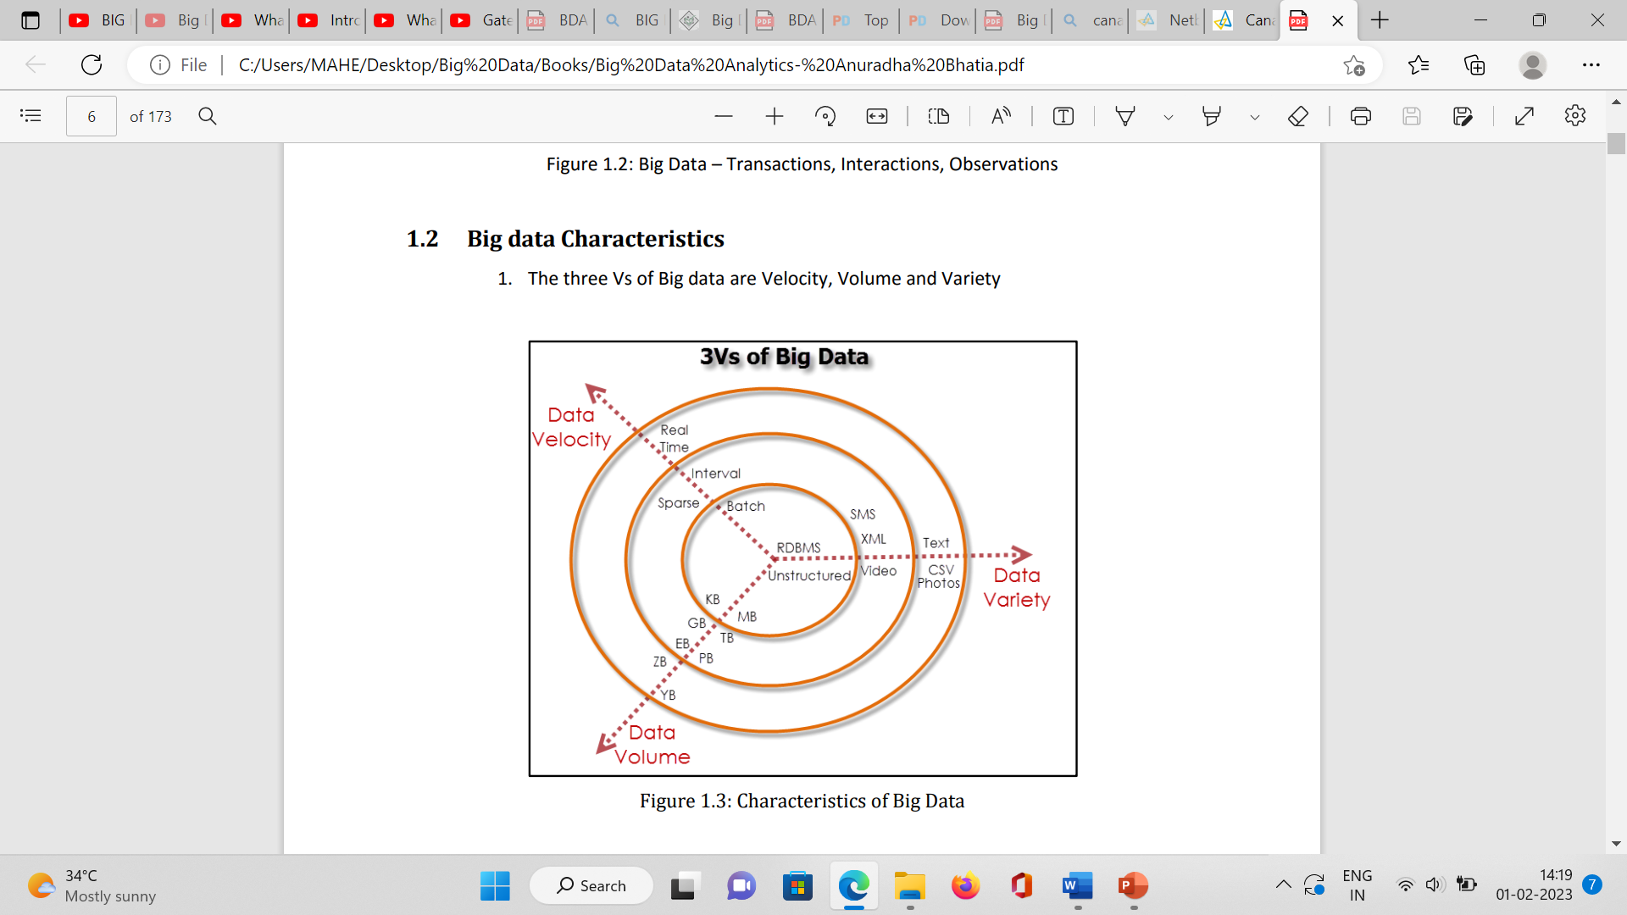
Big Data Characteristics
Volume: Related to size of the data
Variety: Comprises of a variety of data
Velocity: Refers to the speed of generation of data.
Veracity: Quality of data captured, which can vary greatly, affecting its accurate analysis

Slide 20
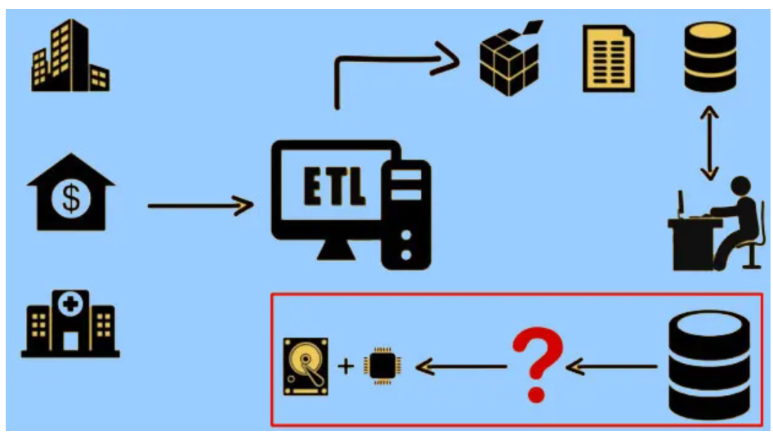
Traditional Approach: Data storage and processing

Slide 21
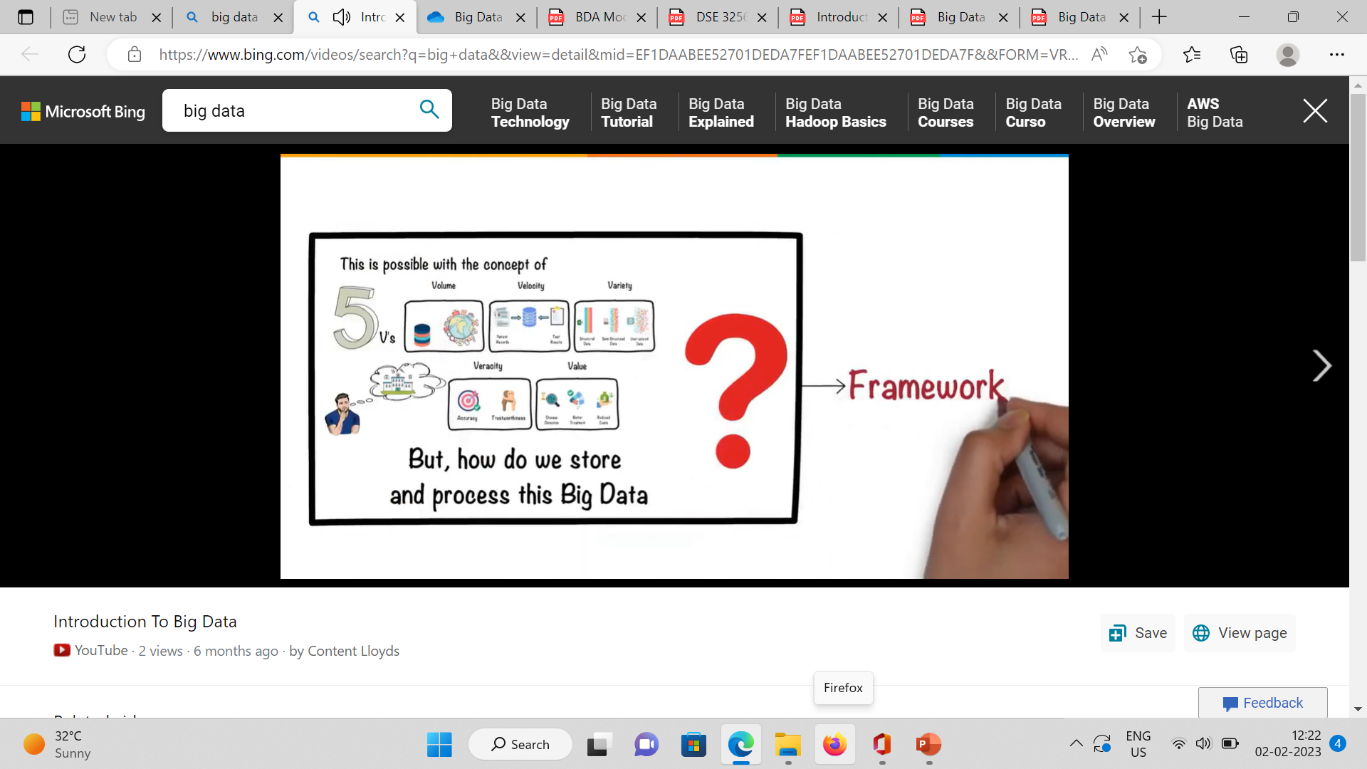
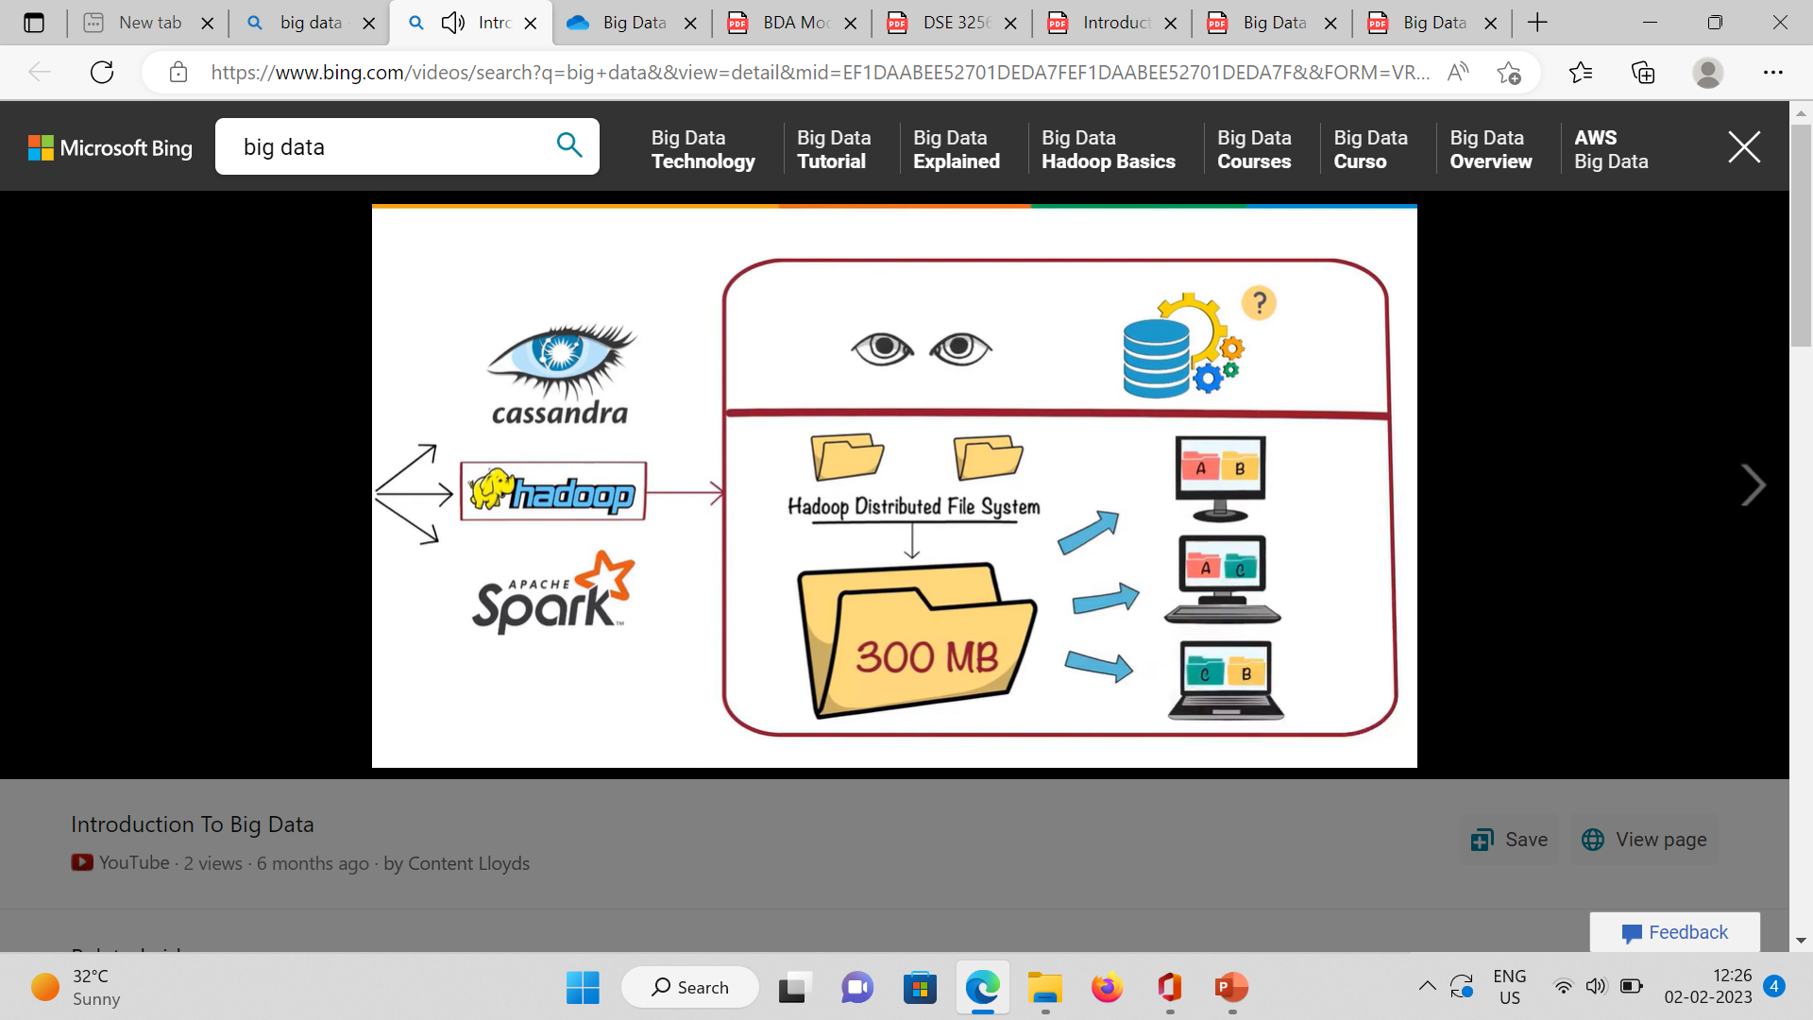
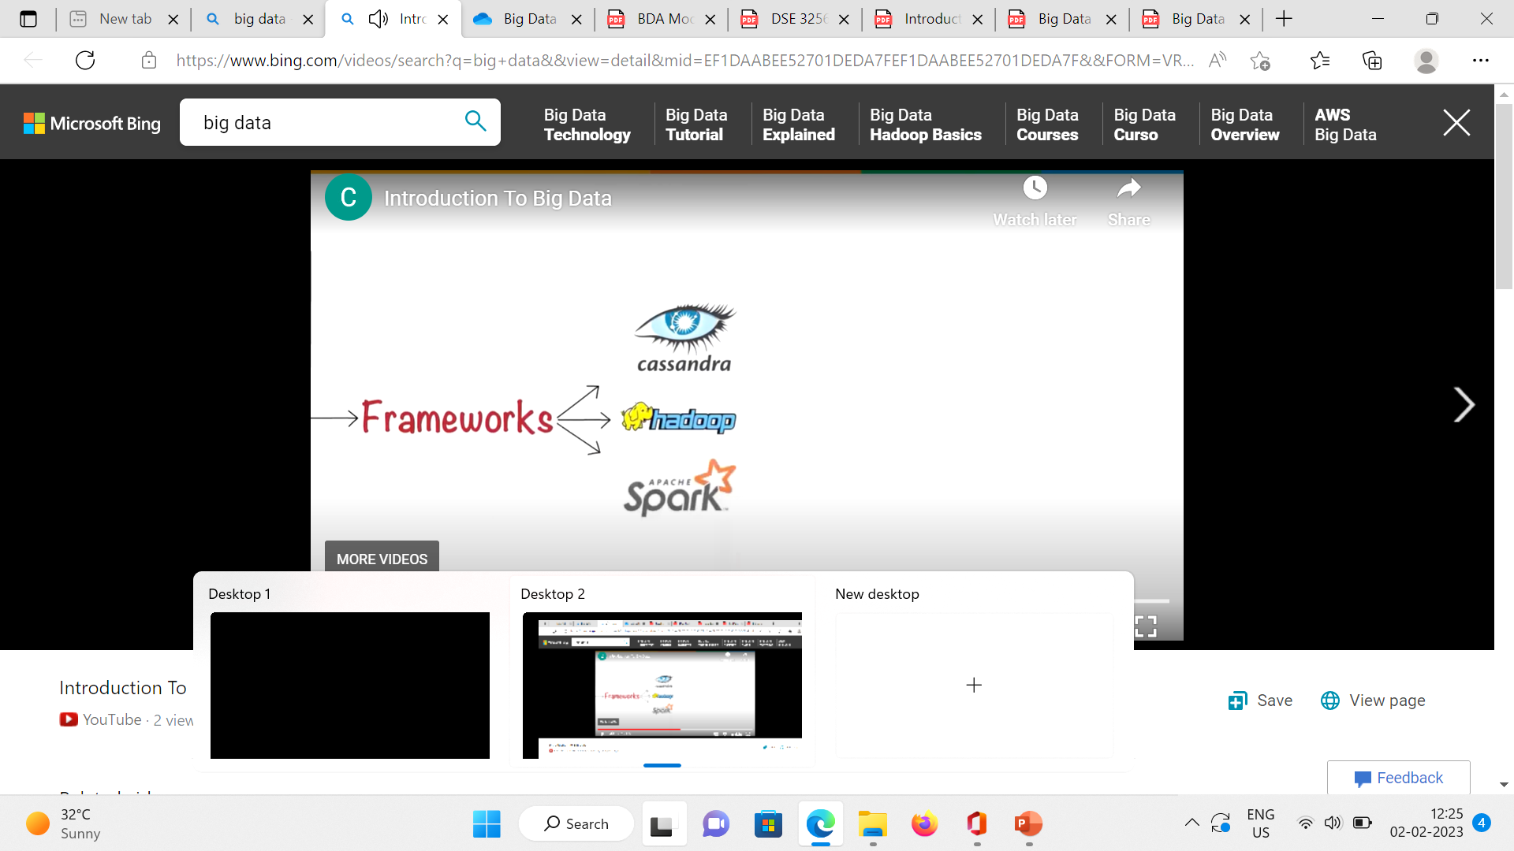
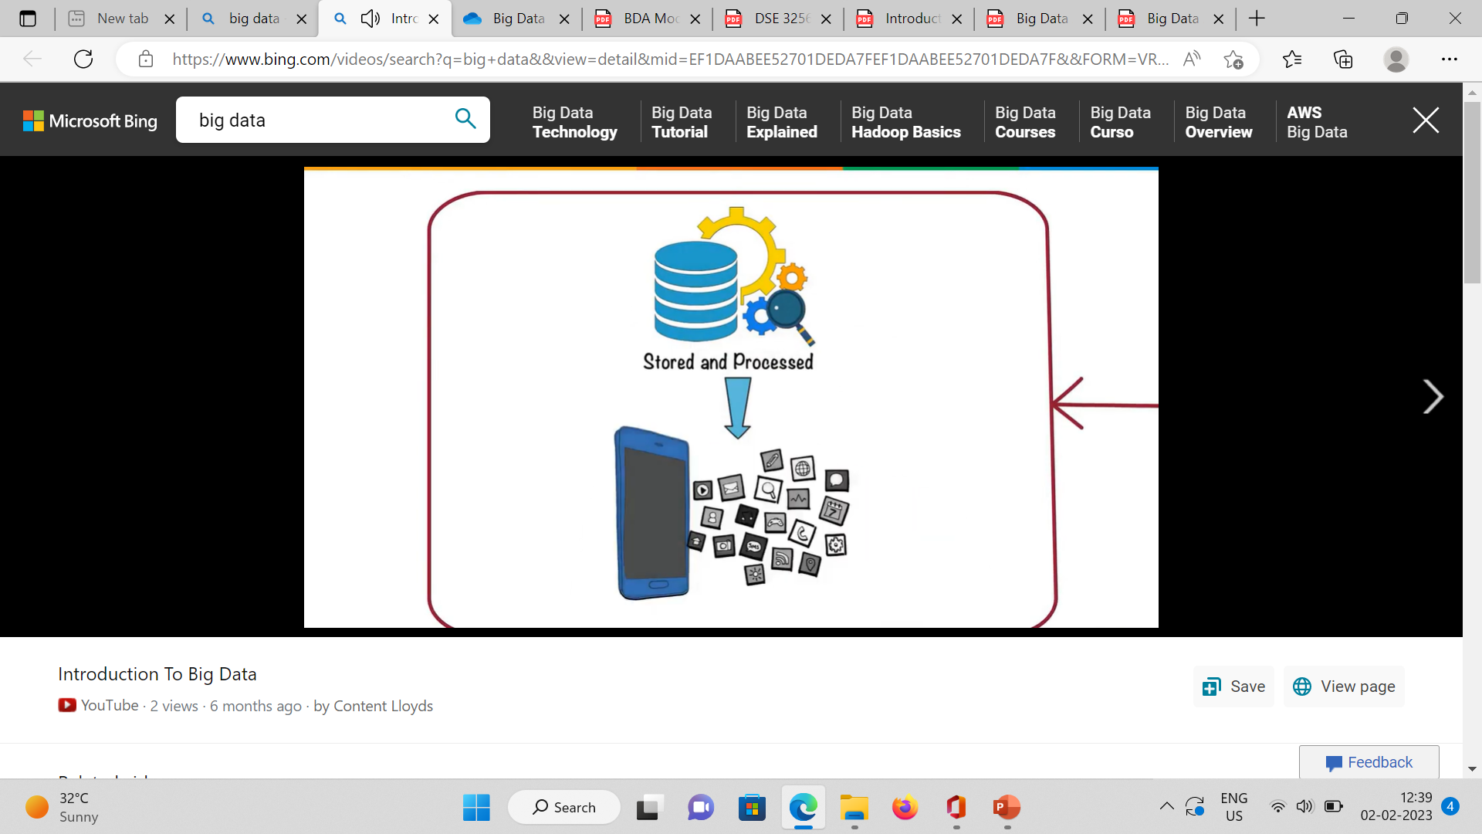
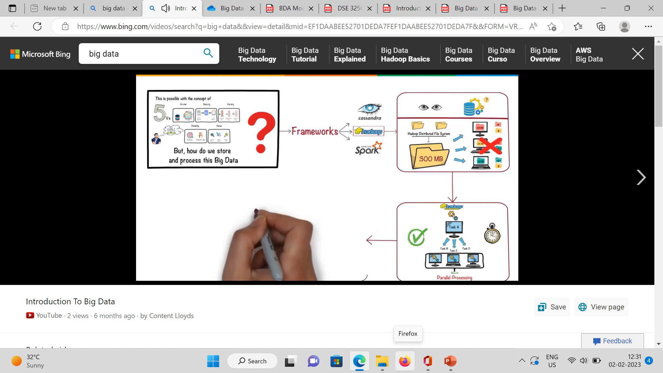
How we store and process this Big Data?
Store – Break file in to small sizes – 300 MB = 128Mb, 128 MB, 44MB
Store them with different nodes – when node breaks down it will be easy to to fetch the file
MapReduce/ Processing
Data Analysis

Slide 22
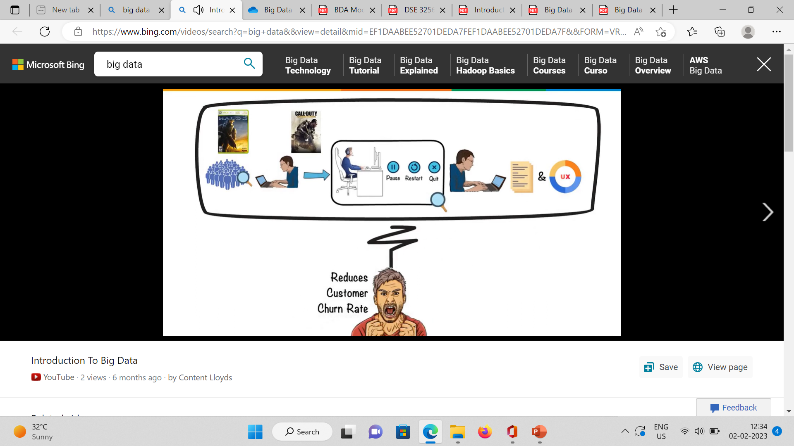
Use case of Big Data Analysis – Gaming
Designers Analyze gaming data at which stage customers pause , restart , quit etc.
This analysis will help designers to work on enhancement of story line of games.
Improve “user Experience”
Reduce Churn rate.

Slide 23
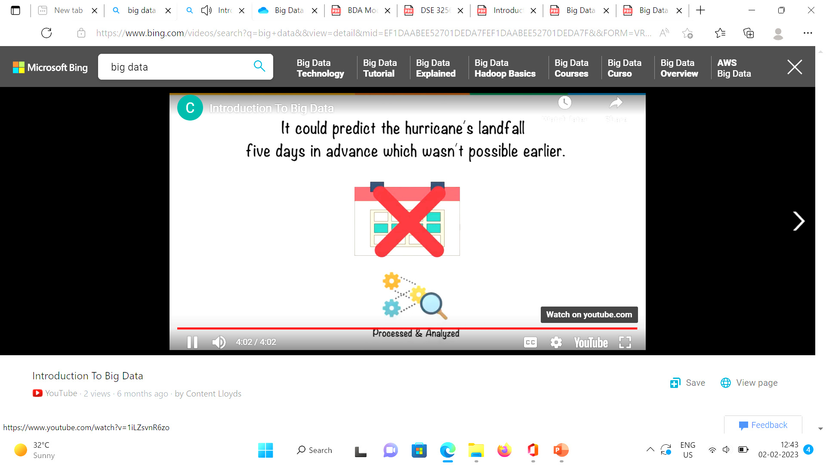
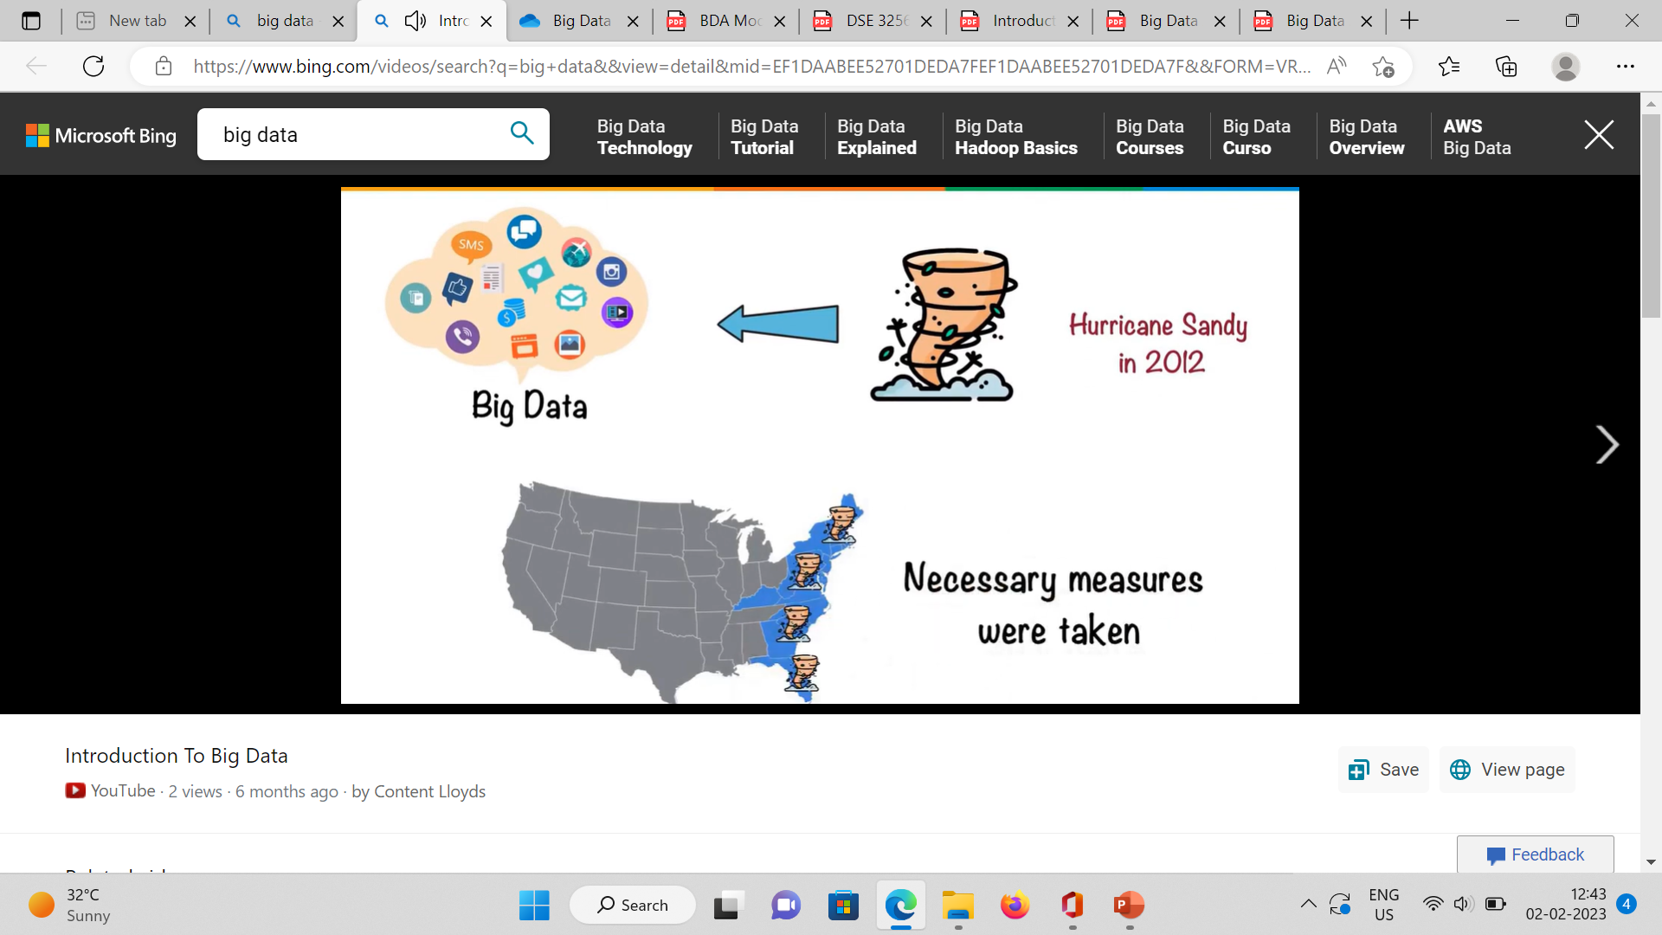
Use case of Big Data Analysis: Predict Hurricane’s landfall
Processed
Analyzed Accurately

Slide 24
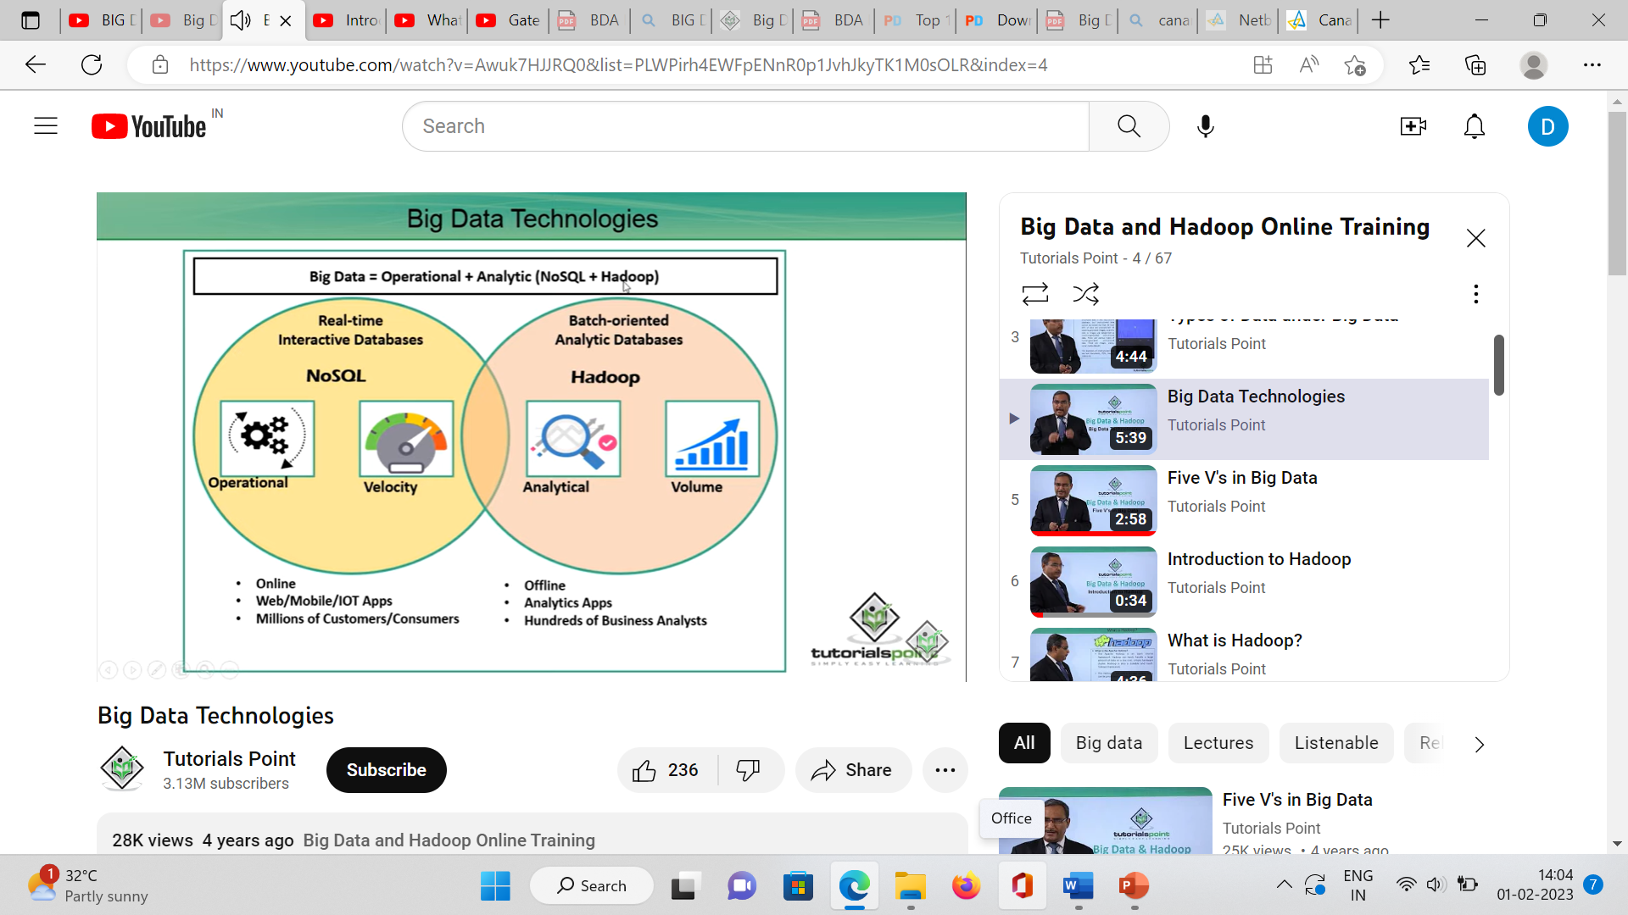
Big data Technologies/ Classes

Slide 25
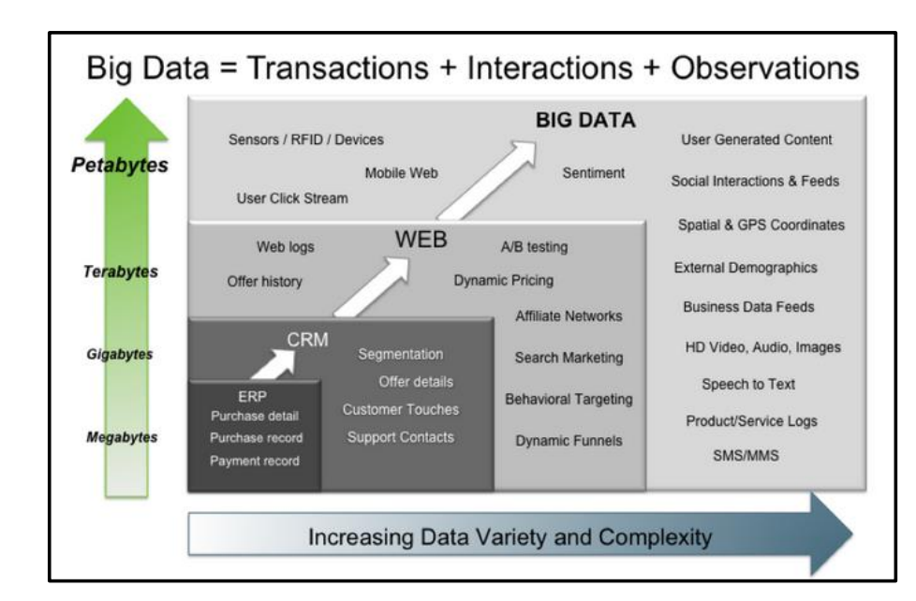
Big Data?

Slide 26
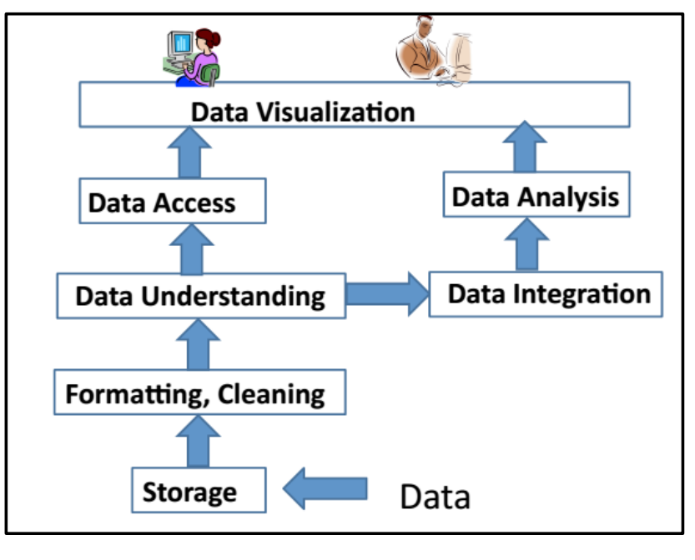
Big Data Layout
Apache Hadoop- Apache
MapReduce – Google
HDFS(Hadoop distributed file system) – Apache
Hive – Facebook
Pig - Yahoo
Figure : Big Data layout

Slide 27
Apache Hadoop
Apache Hadoop is one of the main supportive element in Big Data technologies.
It simplifies the processing of large amount of structured or unstructured data in a cheap manner.
Hadoop is an open source project from Apache that is continuously improving over the years.
Hadoop is basically a set of software libraries and frameworks to manage and process big amount of data from a single server to thousands of machines.
It provides an efficient and powerful error detection mechanism based on application layer rather than relying upon hardware."
In December 2012 Apache releases Hadoop 1.0.0, more information and installation guide can be found at Apache Hadoop Documentation.
Hadoop is not a single project but includes a number of other technologies in it.

Slide 28
Hadoop
Main Components
key features
HDFS (Hadoop Distributed File System)
YARN (Yet Another Resource Negotiator)
Mapreduce
Includes several additional modules: Hive ,Pig, and HBase
Distributed Storage
Scalability
Fault-Tolerance
Data locality
High Availability
Flexible Data Processing
Data Integrity
Data Compression

Slide 29
HDFS(Hadoop distributed file system)
HDFS is a java based file system that is used to store structured or unstructured data over large clusters of distributed servers.
The data stored in HDFS has no restriction or rule to be applied, the data can be either fully unstructured or purely structured.
In HDFS the work to make data senseful, is done by developer's code only.
Hadoop distributed file system provides a highly fault tolerant atmosphere with a deployment on low cost hardware machines.
HDFS is now a part of Apache Hadoop project, more information and installation guide can be found at Apache HDFS documentation

Slide 30
MapReduce
MapReduce was introduced by google, which has mapper and reducer modules.
Helps to analyze web logs to create large amount of web search indexes.
It is basically a framework to write applications that processes a large amount of structured or unstructured data over the web. (programming model)
MapReduce takes the query and breaks it into parts to run it on multiple nodes.
By distributed query processing it makes it easy to maintain large amount of data by dividing the data into several different machines.
Hadoop MapReduce is a software framework for easily writing applications to manage large amount of data sets with a highly fault tolerant manner.
More tutorials and getting started guide can be found at Apache Documentation.

Slide 31
HIVE
Hive was originally developed by Facebook, now it is made open source.
Hive works something like a bridge in between SQL and Hadoop, it is basically used to make SQL queries on Hadoop clusters.
Apache Hive is basically a data warehouse that provides ad-hoc queries, data summarization and analysis of huge data sets stored in Hadoop compatible file systems.
Hive provides a SQL like called HiveQL query based implementation of huge amount of data stored in Hadoop clusters.
In January 2013 apache releases Hive 0.10.0

Slide 32
Pig
Pig was introduced by yahoo and later on it was made fully open source.
It also provides a bridge to query data over Hadoop clusters but unlike hive, it implements a script implementation to make Hadoop data access able by developers and business persons.
Apache pig provides a high level programming platform for developers to process and analyses Big Data using user defined functions and programming efforts.
In January 2013 Apache released Pig 0.10.1 which is defined for use with Hadoop 0.10.1 or later releases.

Slide 33
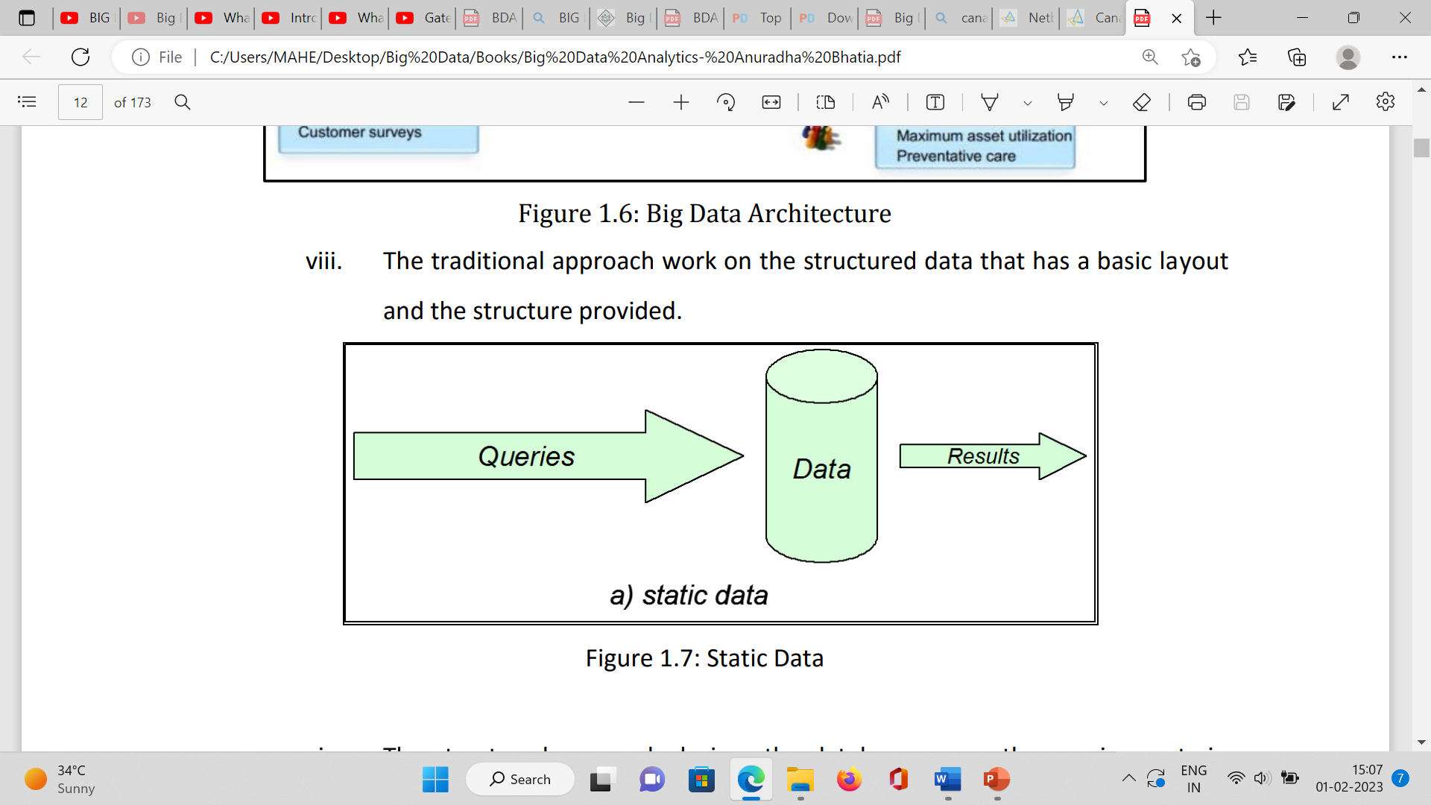
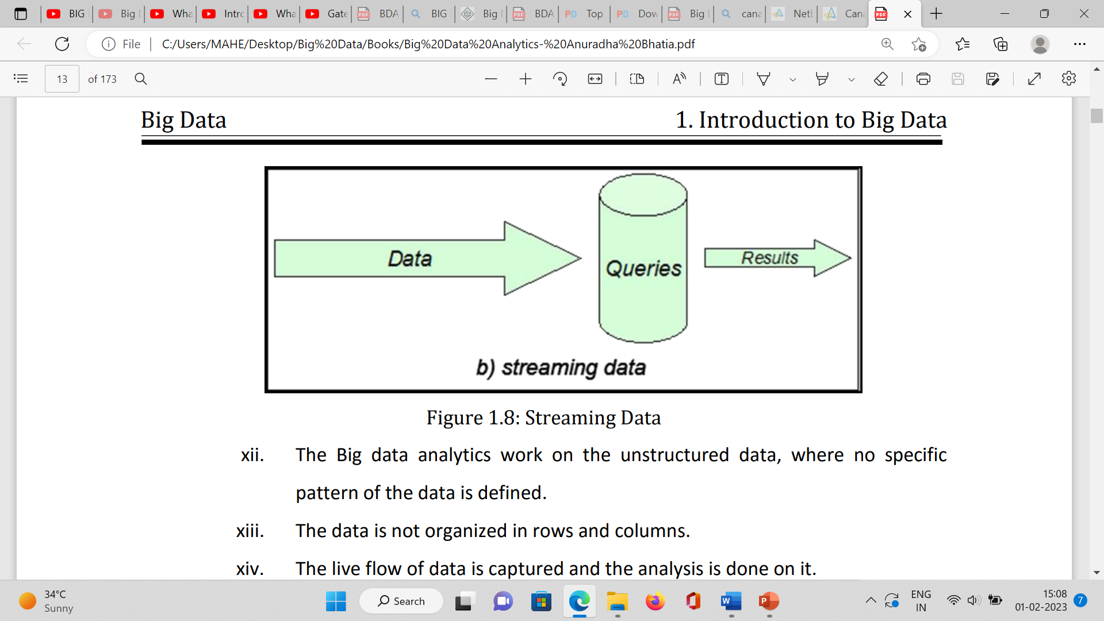
Traditional vs Big Data
Schema Hard Code/SQL/Small Data
online transactions and quick updates.
Schema Based DB (hard code schema attachment)
Structured
Uses SQL for Data processing
Maintains relationship between elements
Schema Less /NoSQL/Big Data
Migration Easy
Schema Less Based DB
store unstructured, semi structured or even fully structured data
Store a huge amount of data and not to maintain relationship between elements.

Slide 34
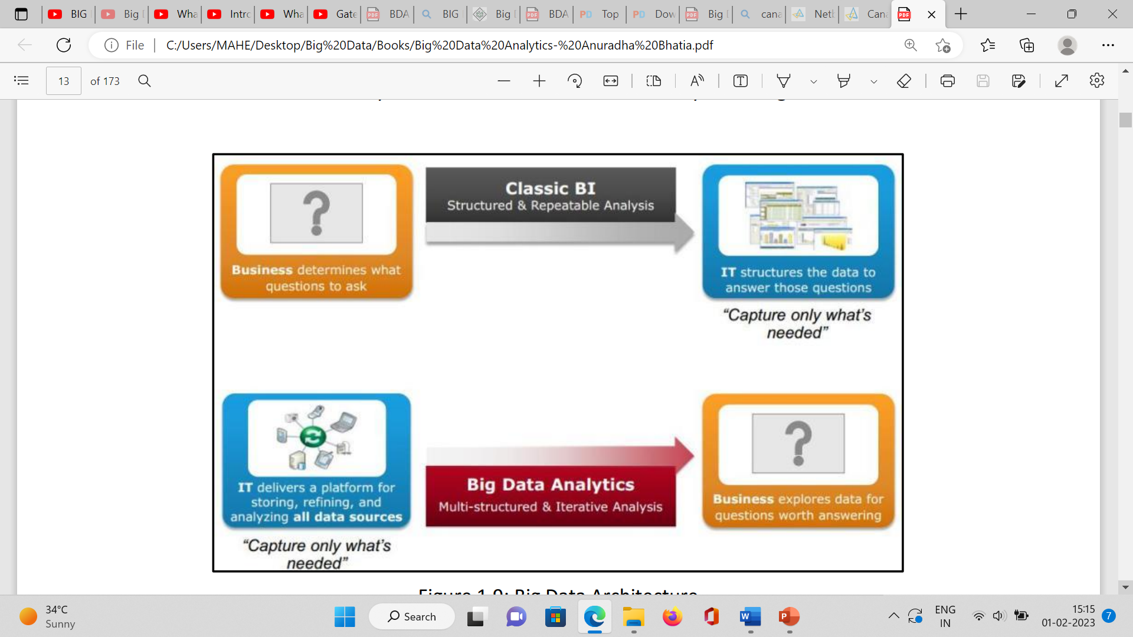
Traditional BI Vs. Big Data Analytics
Working on the live coming data, which can be an input from the ever-changing scenario cannot be dealt in the traditional approach.
The live flow of data is captured and the analysis is done on it.
Efficiency increases when the data to be analyzed is large

Slide 35
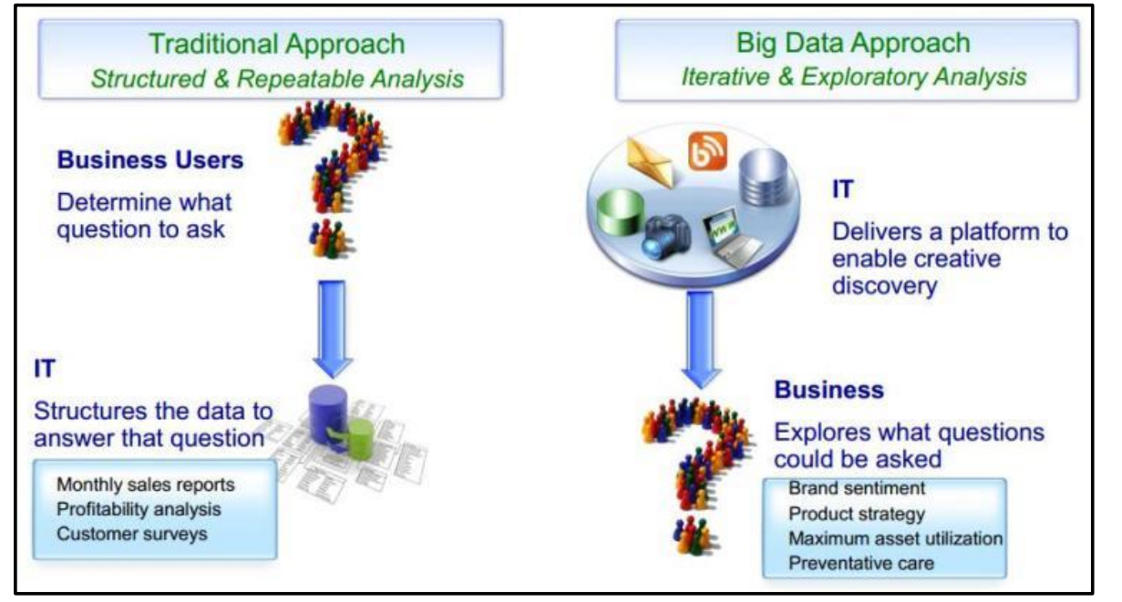
Traditional vs Big data Approaches

Slide 36
What is Changing in the Realms
of
Big Data ??????

Slide 37
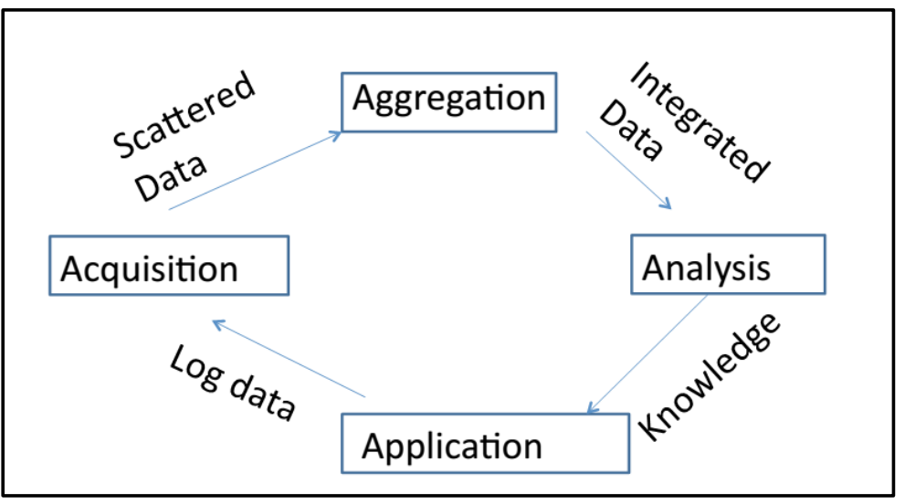
Life Cycle of Data
The analysis of data is done from the knowledge experts and the expertise is applied for the development of an application.
The streaming of data after the analysis and the application, the data log is created for the acquisition of data.
The data id mapped and clustered together on the data log.
The clustered data from the data acquisition is then aggregated by applying various aggregation algorithms.
The integrated data again goes for an analysis.
The complete steps are repeated till the desired, and expected output is produced

Slide 38
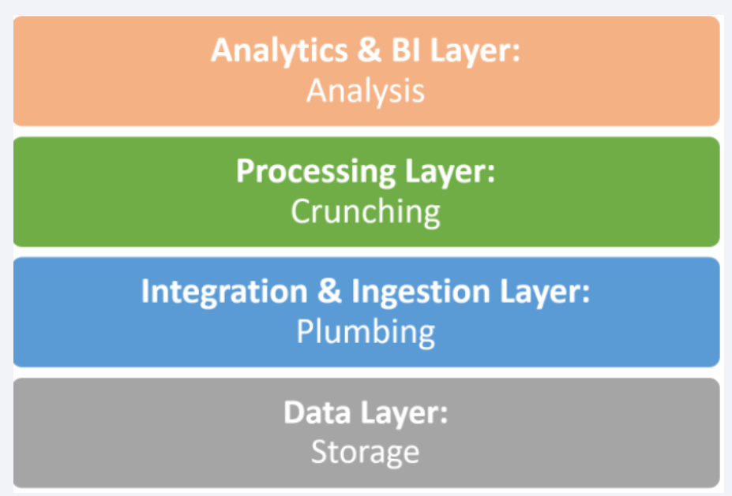
Big Data Technology Stack

Slide 39
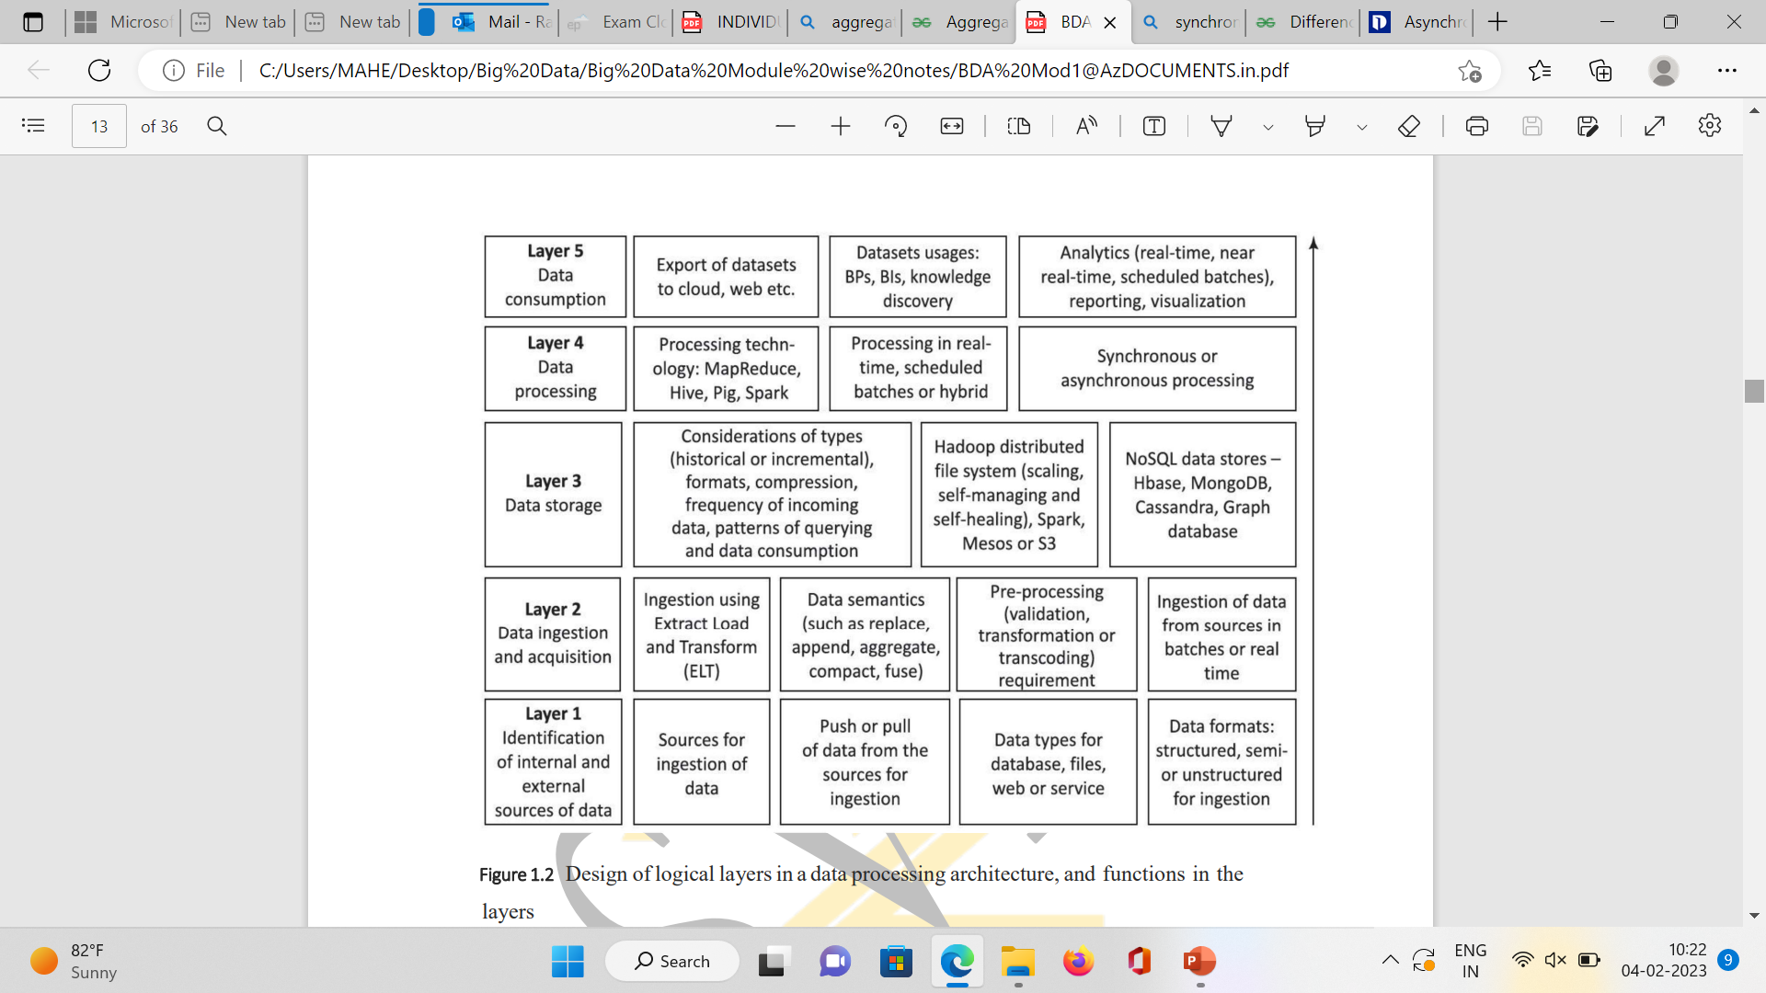
Design of logical layers in a data processing

Slide 40
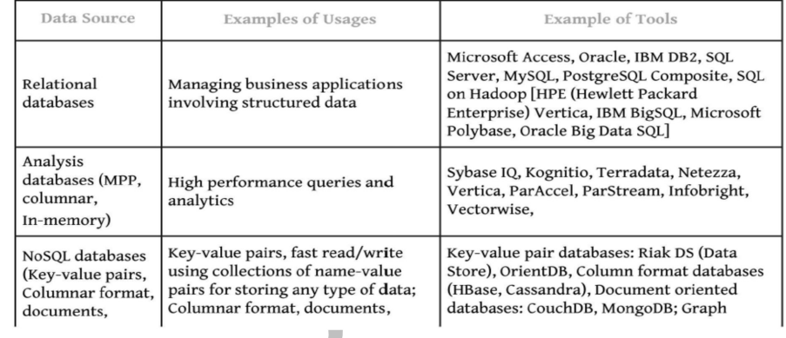
Various Data Storage and Usage, Tools

Slide 41
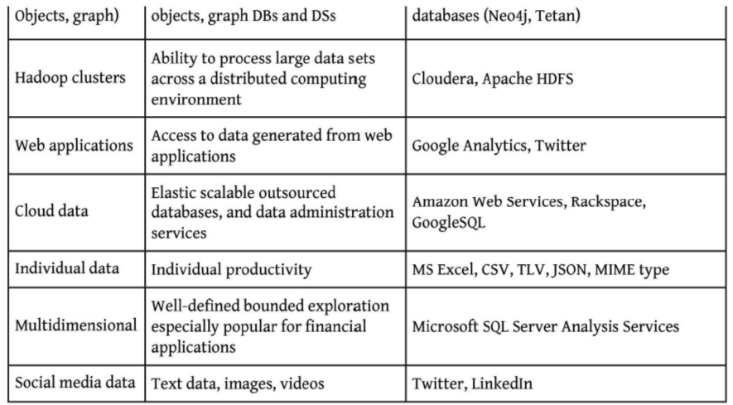
Various Data Storage and Usage, Tools

Slide 42
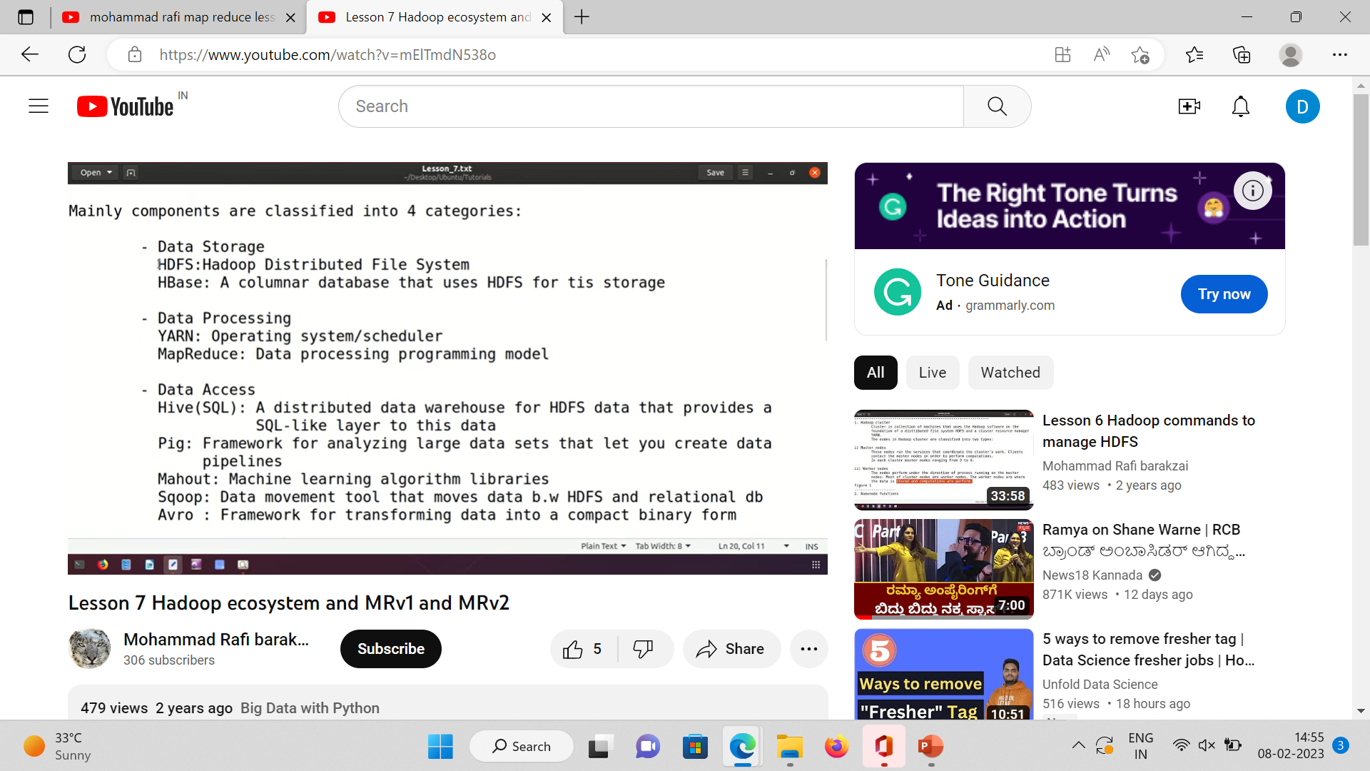
Components Classification in Hadoop

Slide 43
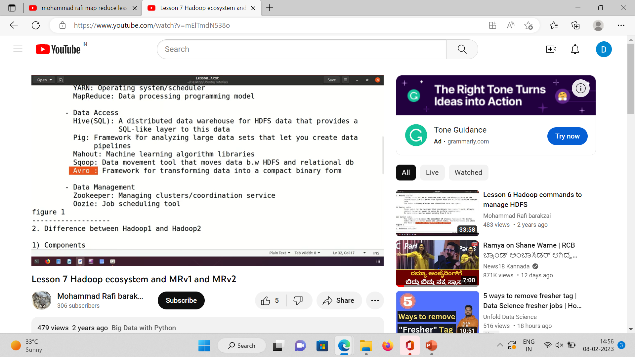
Components Classification

Slide 44
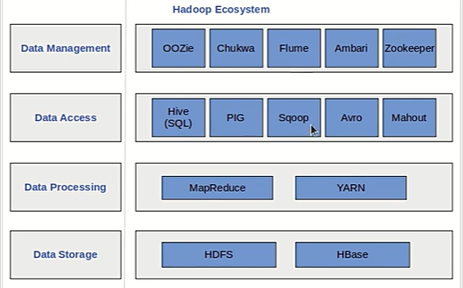
Hadoop Ecosystem

Slide 45
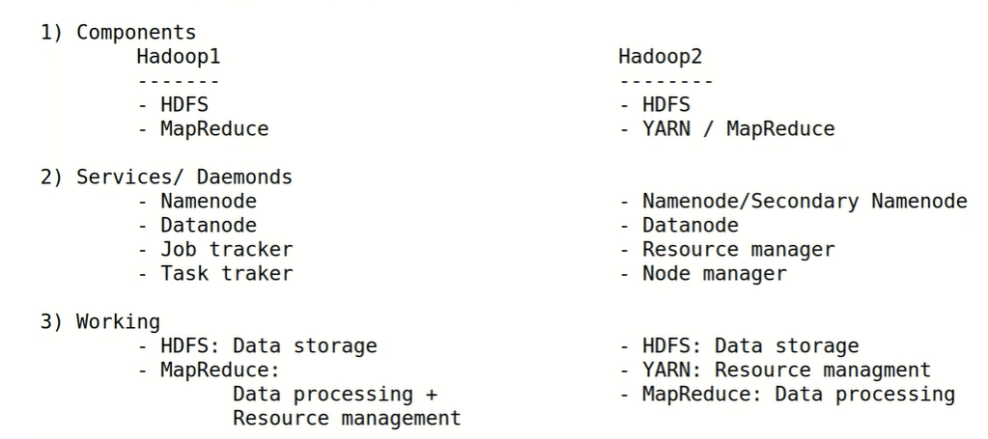
Hadoop 1 vs Hadoop 2 [MRV1 vs MRV2]

Slide 46
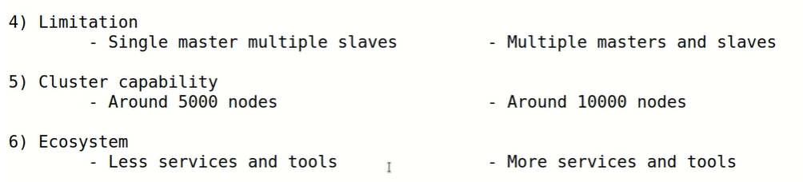
Hadoop 1 vs Hadoop 2 [MRV1 vs MRV2]

Slide 47
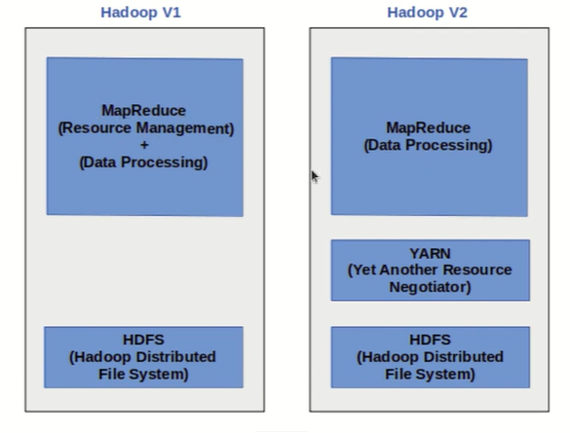
Hadoop V1 vs Hadoop V2

Slide 48
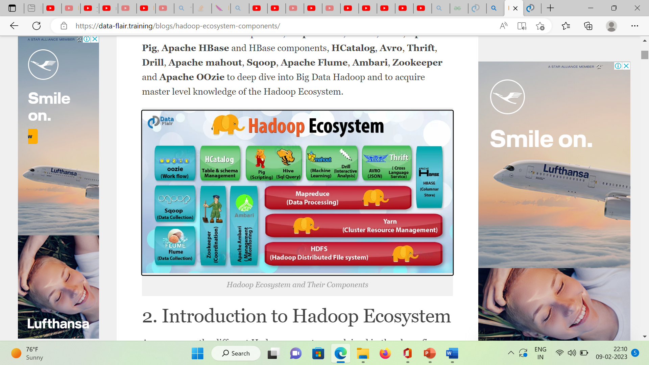

Slide 49
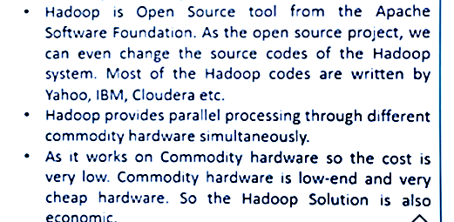
Hadoop Technology

Slide 50
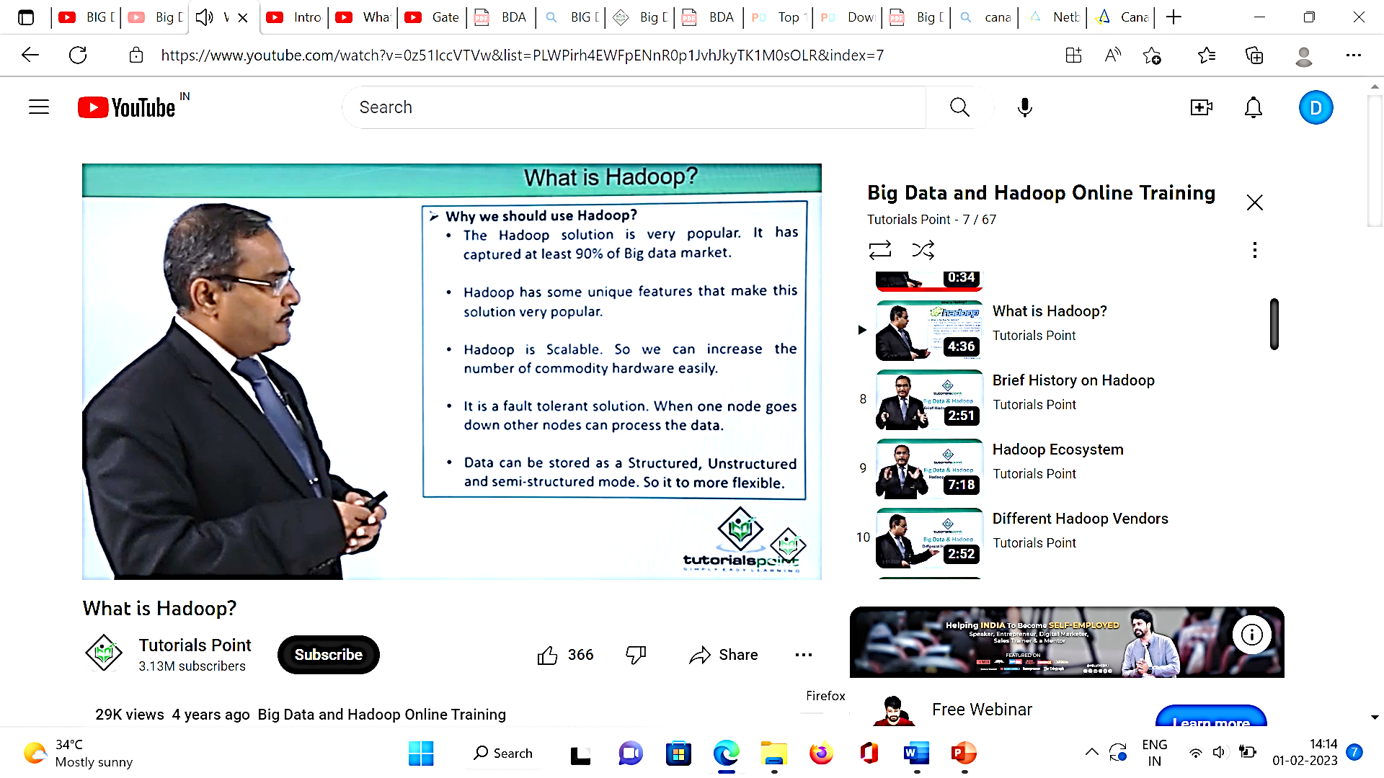
Why TO Use Hadoop?

Slide 51
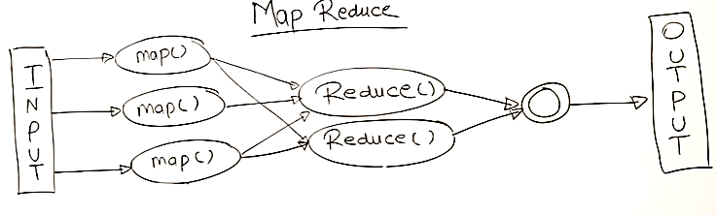
MapReduce:

Slide 52
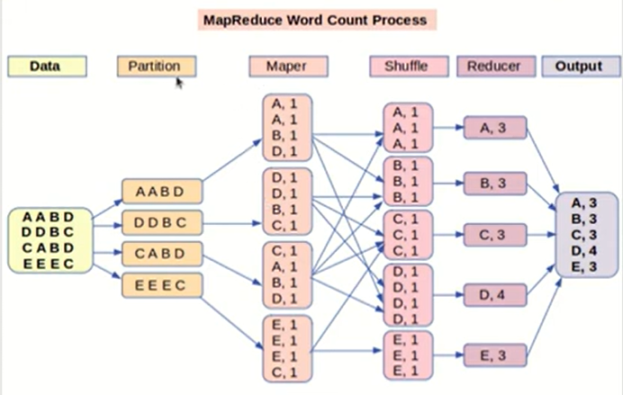
MapReduce

Slide 53
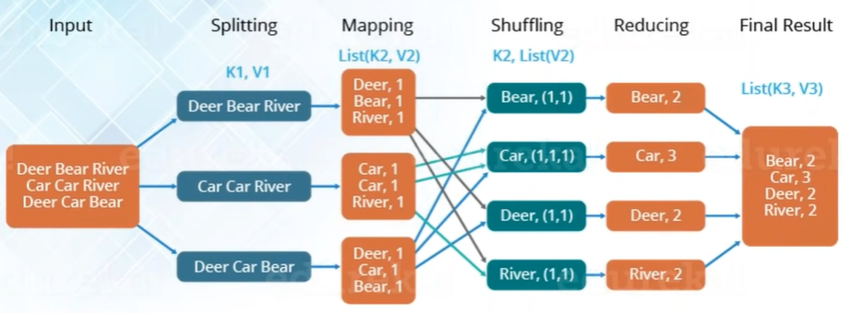
Phases of MapReduce: Word Count

Slide 54
MapReduce : Case Study (Paper Correction and Identifying Topper)
Map : Parallelism , Reduce : Grouping
Total = 20 Papers
Time = 1 min/Paper
Without (MPP):
20 Papers Corrections = 20 mins
With (MPP/MapReduce)
Divide Task – 4 groups / 4 districts (D1, D2, D3, D4) [Divide Tasks – Mapper Class]
Assign 5 papers- Each district
To fetch “District Topper” = (D1 =T1, D2= T2, D3 = T3, D4 = T4) = 4 Toppers ; 5 minutes
To fetch “State Topper” = T1, T2, T3, T4 = Topper; 4 minutes [Aggregation: Reducer Class]
Total job “To Fetch Topper” = 9 Minutes
Summary/ Technicality of MapReduce : Time is reduced rapidly in case of MPP application.

